Slide 1
Optimization-Based Full Body Control for the DARPA Robotics Challenge
Siyuan Feng
Mar. 14 2014

Slide 2
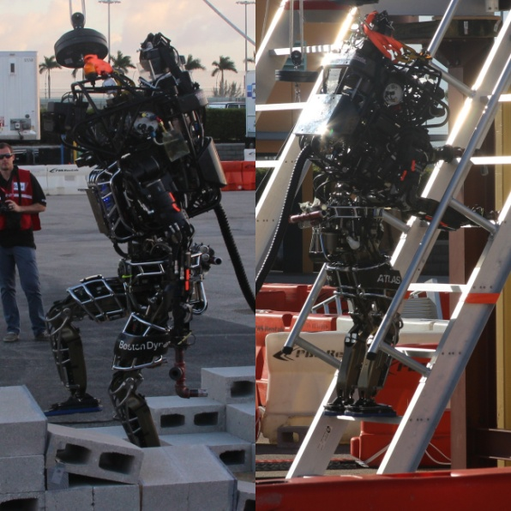
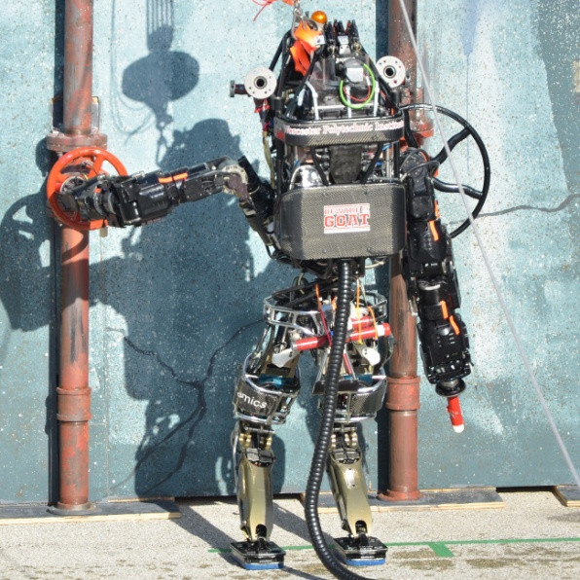
Introduction
We want a generalized
controller that works
for a variety of tasks.
This is a complex optimization
problem, so we factor it into
two stages.

Slide 3
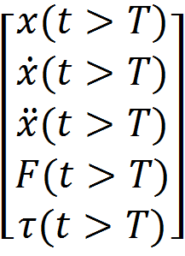
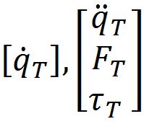
NOW
FUTURE
QP
DDP
Full model
Simple model

Slide 5
Related works
Reference motion generation (Long term)
Preview control
Full dynamic programming
RHC with foot step adjustment
Floating base inverse dynamics (Instantaneous)
Prioritized inverse dynamics
Reduced model using CoM and angular momentum
Orthogonal decomposition

Slide 6
Outline
Related works
Low level controller
Inverse dynamics
Inverse kinematics
State estimation
High level controller
Walking
Ladder climbing
Manipulation
Discussions

Slide 8
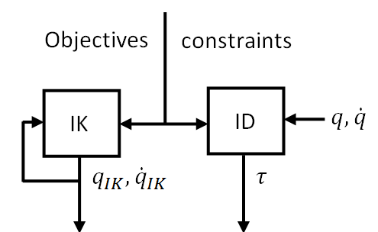
Low level controller
Both inverse dynamics and inverse kinematics
ID for compliance
IK to battle modeling errors
ID and IK are formulated as quadratic programming problems optimizing for the current time step.
Based on the full model (floating base)
Have control over full state
Easy to specify constraints

Slide 9
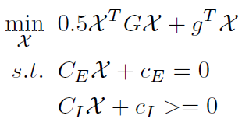
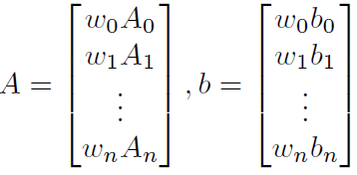
QP formulation
Cost function:
Each row represents an objective:

Slide 10
Inverse dynamics
Uses desired motions from the high level controller and estimated robot states to compute target acceleration with feedback

Slide 11
Inverse dynamics
Cost function:
Target CoM / torso / limb acceleration tracking
CoP tracking
Weight distribution
Change in torque and force
Regularization
Constraints:
Equations of motion
CoP within the support polygon
Torque limits

Slide 12
Inverse kinematics
Maintains its own state
Integrate to get
Uses desired motions from high level controller and internal states to compute target velocity with feedback

Slide 13
State estimation
Simple kinematic filter (EKF) just for pelvis position and velocity estimation
Process model: based on IMU’s acceleration measurement
Observation model: assumes known stationary contact and kinematics

Slide 14
Outline
Related works
Low level controller
Inverse dynamics
Inverse kinematics
State estimation
High level controller
Walking
Ladder climbing
Manipulation
Discussions

Slide 15
Simulated walking

Slide 16
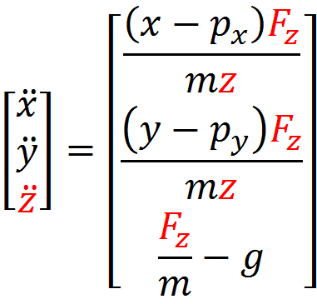
Optimizing CoM trajectory
Generates CoM trajectory for a point mass model with Differential Dynamic Programming (DDP)
Uses a nonlinear model

Slide 17
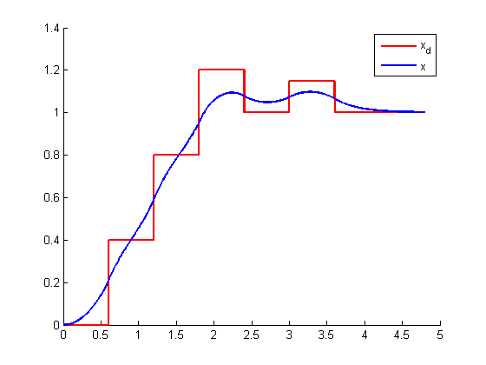
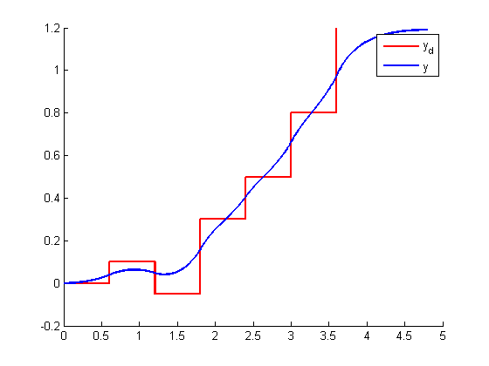
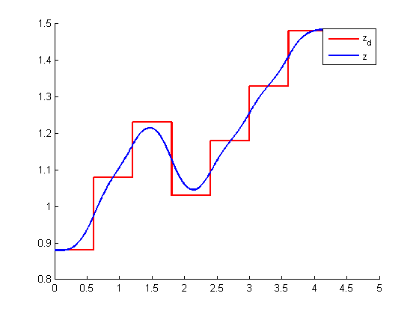
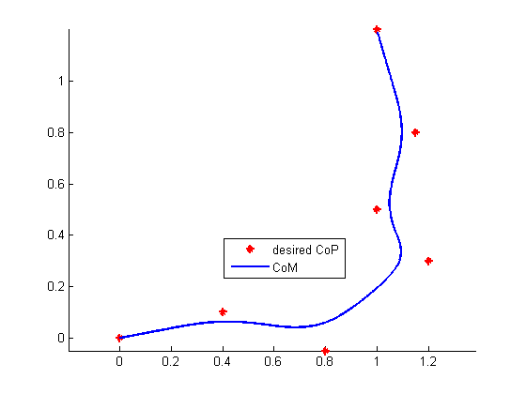
y vs t
x vs t
x vs y
z vs t

Slide 18
Atlas static walking

Slide 19
Atlas static walking
Foot step selection is entirely manual based on a live camera stream.
Toe off is needed for stepping up or long stride
Ankle is purely torque controlled
Integrators
CoM
Swing foot

Slide 20
Atlas ladder climbing

Slide 21
Atlas ladder climbing
Foot / hand reposition is scripted, but final adjustment is done by the operator.
Intentionally leaning on railings to stop yaw rotation
More kinematic constraint management due to tight spacing between railings

Slide 22
Atlas full body manipulation

Slide 23
Remarks about our controller
2-stage setup made concurrent development for multiple tasks possible.
The low level controller is generic enough and seems to be effective for the 3 tasks.
Inconsistency between IK and ID?
Can bias either solution to the other’s
Empirically consistent without constraint violation
Need to reason about the future to steer away from constraints -> can’t be solved at this stage

Slide 24
Remarks about Atlas
Going slow made things much easier
Can use integrators
Delay is not a big deal
Position and torque sensing are pre-transmission
FK has much more error
Joint friction is not measured at all
Terms we used in the joint servos
k_q_p, k_qd_p
k_f_p, ff_qd is transformed by moment arm

Slide 25
Next step
Try to model modeling errors / better state estimation
High level controller
Include angular momentum
Re-optimize step timing and location based on current state
Low level controller
Coordinate IK and ID better
Add a notion of future in QPs through value function
Valve command in ID?

Slide 26
Questions?

